Slide 1

PROCESS MINING VIRTUAL INTERNSHIP
by
B.GUNA TEJA
Roll No. 224G5A3204
Department of Computer Science and Engineering (Data Science)
Srinivasa Ramanujan Institute of Technology
(Affiliated to JNTUA & Approved by AICTE) (Accredited by NAAC with ‘A’ Grade & Accredited by NBA (EEE, ECE & CSE)
Rotarypuram Village, B K Samudram Mandal, Ananthapuramu – 515701.
2023 - 2024

Slide 2

Contents
Course Objective
Introduction
Technology
Applications
Modules
Real Time applications
Learning outcomes
GitHub Link
Queries

Slide 3
Course Objective
Objective of process mining is to teach participants the fundamentals of process mining and how to use it to improve business processes.
To gain a Deep Understanding the fundamental concepts and principles of process mining.
The key objective of a process mining course is to provide a general understanding of the concepts and techniques behind process mining.
Ability to use process mining tools and software effectively.
To be able to apply process mining to improve business processes in a variety of industries.

Slide 4
Introduction
Process mining is a data-driven methodology that focuses on the analysis of event data to gain insights into real-world business processes.
It involves the extraction, visualization, and analysis of information from event logs to understand how processes are actuall executed, identify inefficiencies, and improve overall performance.
Process mining is a discipline that uses data mining techniques to extract knowledge from event logs of business processes.

Slide 5
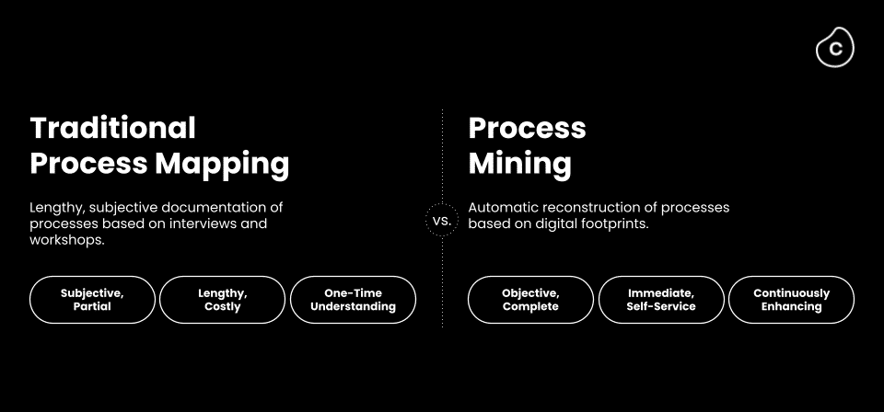
Intro....
Process Mining is the leading new technology when it comes to talking about algorithmic businesses
Process Mining is a solution to costly and time-intense efforts to get data-driven insights into a business.

Slide 6
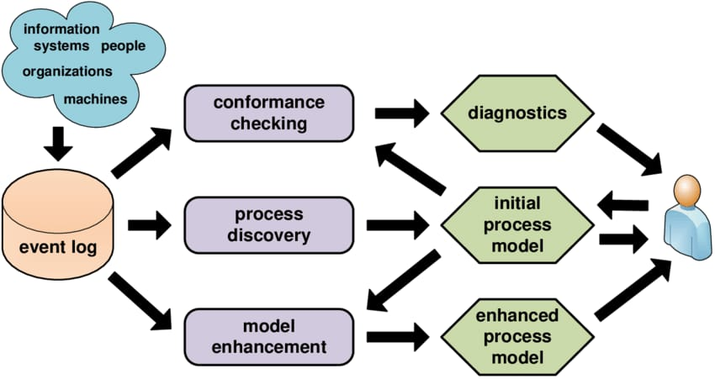
Technology
There are three main groups of process mining techniques

Slide 7
Contd....
Some popular process mining technologies include:
Process Discovery: is a primary technique and implies extracting and visualizing process models from an event log.
Conformance Checking: compares the actual process with a predefined model to discover deviations. So, it’s is used to check if the reality conforms to an existing pattern.
Performance Analysis: These technologies analyze process execution data to identify bottlenecks, inefficiencies, and opportunities for optimization. They provide insights into process cycle times, resource utilization, and other performance metrics.

Slide 8
Applications
Process Improvement:
Analyzing event logs helps identify bottlenecks, inefficiencies, and areas for optimization in processes, leading to better resource allocation and streamlined workflows.
Performance Monitoring:
It provides real-time visibility into ongoing processes, enabling performance monitoring, early detection of issues, and prompt intervention.
Root cause Analysis:
Identifying the causes of process-related problems becomes easier, enabling organizations to address underlying issues effectively.

Slide 9
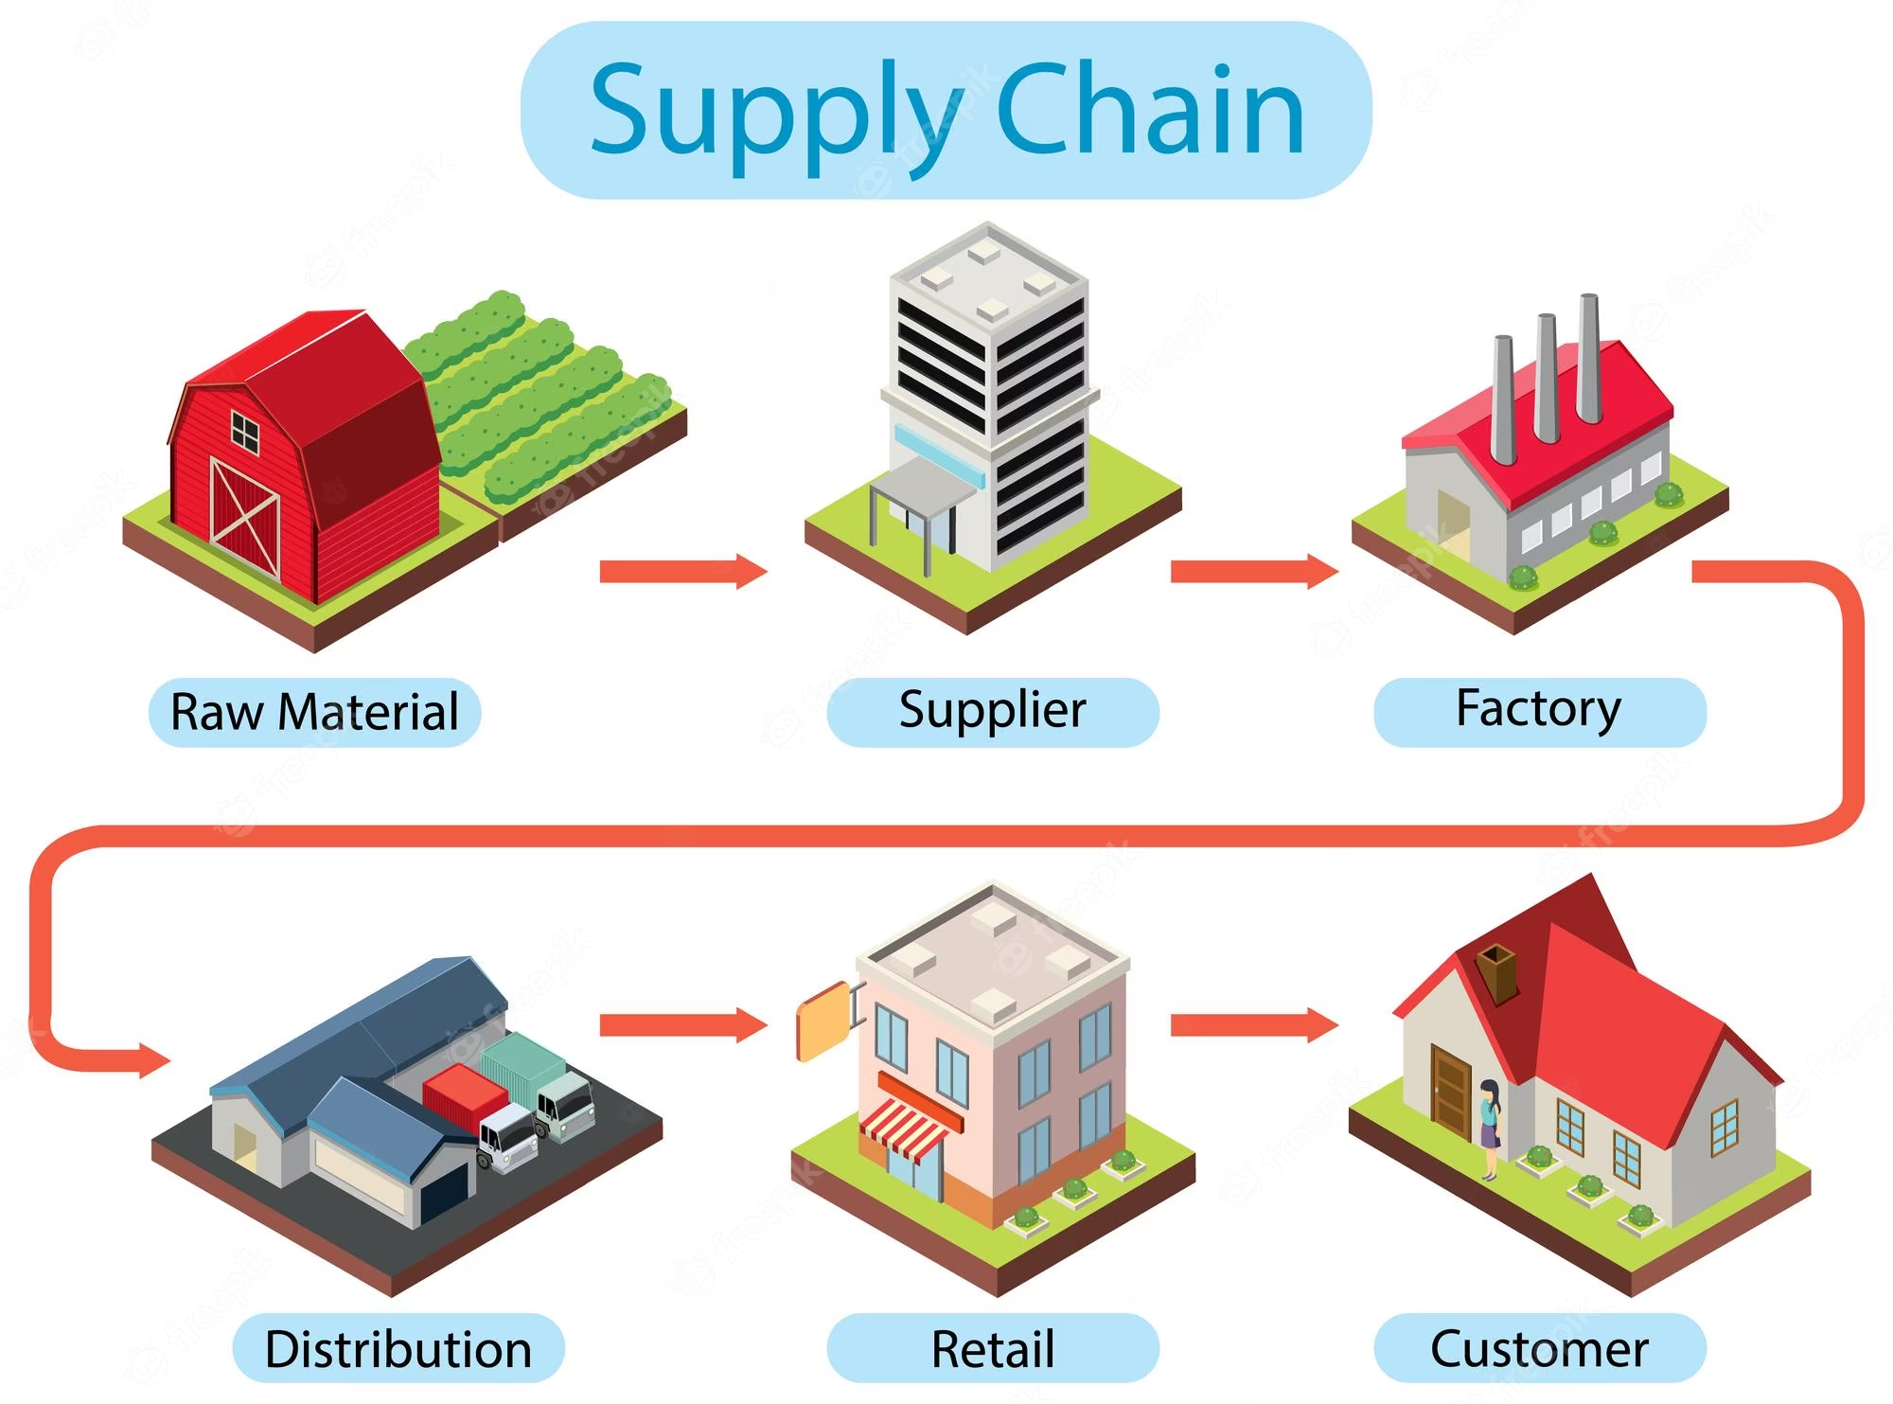
Contd....
Supply Chain Management:
Process mining can track the flow of goods and materials, helping organizations identify delays and inefficiencies within the supply chain.

Slide 10
Modules
Data preparation:
This step involves collecting and cleaning the event log data that will be used for process mining. The event log data should contain information about the activities that are performed in the process, the order in which they are performed, and the time it takes to perform each activity.
Process discovery:
This step involves creating a process model from the event log data. The process model is a graphical representation of the process, and it shows the different activities that are performed in the process, the order in which they are performed, and the decisions that are made.
Performance Analysis:
This module involves measuring key performance indicators (KPIs) derived from event logs to assess the efficiency and effectiveness of the process.

Slide 11
Contd....
Data Preprocessing:
In this stage, raw event data is cleaned, transformed, and enriched to ensure its quality and relevance. This might include dealing with missing data, removing duplicates, and aligning timestamps.
Analysis and Visualization:
Process mining tools provide visualizations and metrics to help stakeholders understand process behavior, bottlenecks, inefficiencies, and opportunities for optimization.

Slide 12
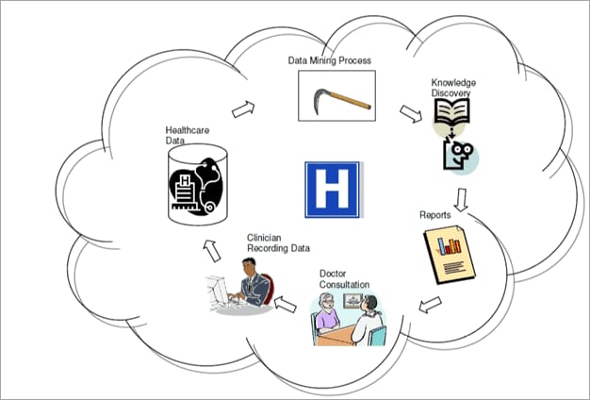
Real-Time Applications
Healthcare Process Monitoring:
In healthcare, process mining can be used to track patient flows, resource utilization, and treatment timelines in real time to enhance patient care.
Risk Management in Banking:
Financial institutions can use process mining to monitor real-time data related to financial transactions and identify potential risks or regulatory non-compliance.

Slide 13
Contd.....
Manufacturing Process Control:
Real-time process mining can monitor manufacturing processes, identifying deviations and ensuring that production lines are running efficiently.
Supply Chain Optimization:
Real-time process mining can help optimize supply chain operations by tracking the movement of goods, identifying delays, and ensuring timely deliveries.

Slide 14
Learning outcomes
Process mining is and its importance in analyzing and improving processes.
Explore various real-world applications of process mining across industries and sectors.
Familiarize yourself with basic process mining software and their functionalities.
process mining to discover and visualize actual processes from event logs.

Slide 15
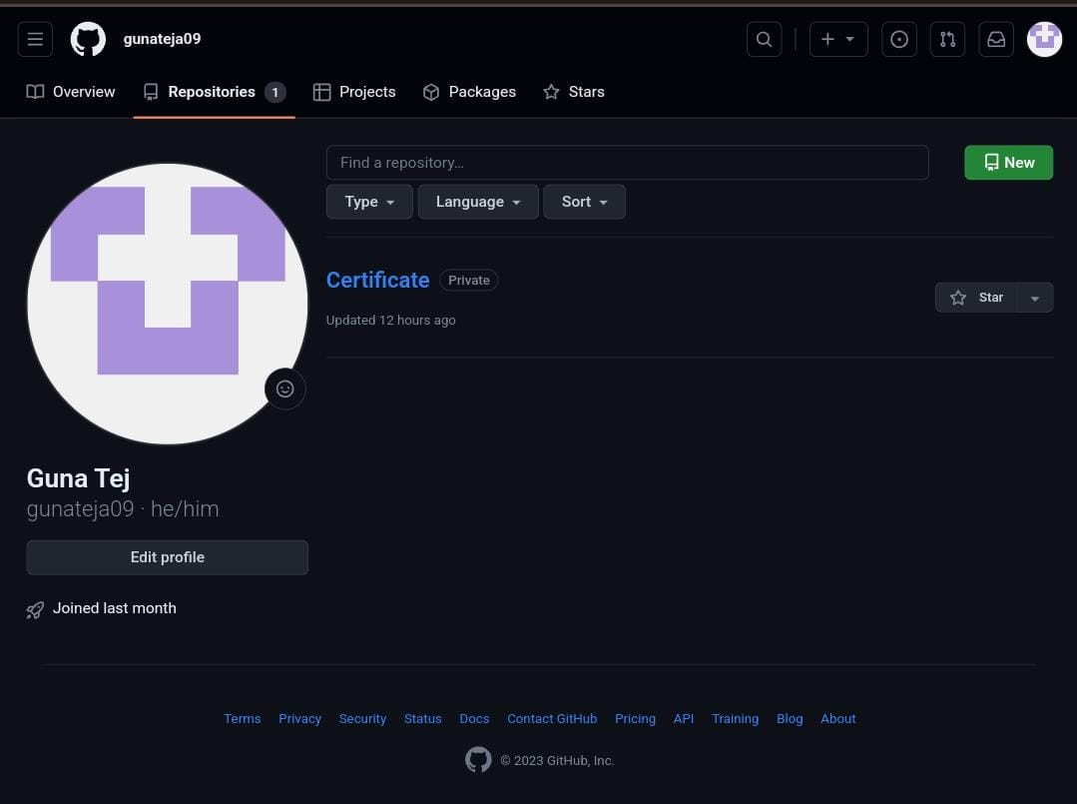
Git Hub Dashboard
Git Hub Link: https://github.com/gunateja09

Slide 16
Any Queries?

Slide 17
Thank You!!!

